Slide 1
Models of Network Price Model
MA 653: Network Science
Instructor: Ashok Singh Sairam
ashok@iitg.ac.in

Slide 2
Acknowledgement
Slides have been heavily borrowed from Prof. Konstantinos Pelechrinis, School of Information Sciences, University of Pittsburgh

Slide 3
Generative network model
The random network models we have seen until now are mainly used to study structural properties of networks
i.e., some parameters are fixed (e.g., number of nodes, number of edges, degree distribution etc.) and we study the properties of the graph (e.g., path lengths, component sizes etc.)
Generative network model: generate synthetic networks that mimic the structural properties of real-world networks.
Network models that model the mechanism that drive the network formation
If the structures resemble real world structures, then this mechanism might be at work in real networks

Slide 4
Price Model:Origin (1)
Many real-world networks exhibit power law distributions
Examples: Internet, WWW and citation network
What are the underlying processes?
How did a network come to have such a distribution?
Price was the first to propose a single and elegant model of network formation

Slide 5
Price Model:Origin (2)
Price was studying citation networks
Nodes are papers. Directed edge if paper 1 cites paper 2. Once a paper is created it is never destroyed. Paper is added one at a time
But his model was inspired by the work of Hebert Simon, an economist
Simon proposed and explanation for the wealth distribution
People who have more money already, gain more at a rate proportional to how much they already have
This can lead to power law distribution for the wealth
“Rich-get-richer”, “cumulative advantage”, “preferential attachment”

Slide 6
Price model: Idea
Price adopted with modifications Simon’s model in the context of (citation) networks
Every new paper (node of the graph) cites on average c other papers (c is thus, the average out degree)
This newly appearing paper cites previously published papers at random
NOT uniformly at random
At random with probability proportional to the number of citations those previous papers have
Simplified model does not consider relevance, originality, difference between research articles and reviews

Slide 7
Price Model:Adjustment
The above cannot be precisely true
A newly published paper has zero citations → a strict proportionality rule would give 0 citations to this paper from then on
Price added a constant factor a > 0 to the citation probability
Some citations come for “free”
An alternative interpretation of this factor is that a part of the papers that one cites are chosen uniformly at random, while the rest are chosen with a probability proportional to the citations these other papers already have

Slide 8
Price model: Initialization
How to initialize the model?
At the limit of a large network the initialization does not alter any of the predictions
Hence, we can start with a few papers that have zero citations each
In summary,
Price’s model is a growing network
New nodes are added continually and never removed
Average out-degree is c
The citations a paper receives are proportional to its in-degree and constant factor a [Price considered a = 1]
The model allows for multi-edges but as with random graphs that do not affect the results at the limit of large network

Slide 9
Price model: properties
Price model creates acyclic graphs
This aligns with the initial goal to model citation networks
What about other directed networks that are not acyclic? E.g., the Web
What is the in-degree of vertices in the price model?
We denote for simplicity the in-degree of vertex i as q_{i}
Let p_{q}(n) be the fraction of vertices that have in-degree q when the total number of vertices in the network is n
What happens when a new vertex is added to the network?

Slide 10
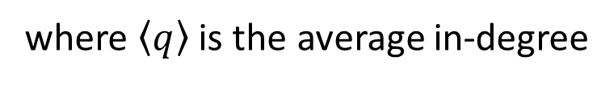
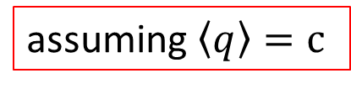
Price Model: degree distribution
This new vertex will create new citations/edges
The probability that a new edge points to a node i is proportional to q_{i}+a:
This new vertex does c citations → the expected number of new in-edges of node i is c times the above quantity
The expected number of new edges pointing to all vertices of in-degree q, or, Expected number of vertices with previous degree q which received another edge and became vertices with degree q+1 is:
where $\left\langle q\right\rangle$ is the average in-degree
assuming $\left\langle q\right\rangle =c$

Slide 11
Price Model: degree distribution
Let’s calculate what is the number of vertices with degree q after the addition of this new vertex
A node with in-degree q can appear because a node with degree q-1 received a new citation
However, a node with in-degree can disappear because it received a new citation and hence, its in-degree is now q+1
Hence the expected number of nodes with in-degree q when we add one vertex (i.e., total nodes n+1) is:
#nodes previously of in-degree q
#nodes gained
#nodes lost

Slide 12
The master equation we saw previously does not hold true as is for the case of q=0
There are no vertices of lower in-degree so the second term cannot appear
However, when we add a new vertex its in-degree is by default 0 → we add one node of degree 0
Let’s examine the asymptotic behavior of the distribution
Assuming that it indeed converges for large n, we use the shorthand p_{q}=p_{q}(∞)

Slide 13
Then we get:
Re-writing the above equations we can get:
After some involved calculations p_{q} can be written as:
B(x,y) is the Euler’s beta function

Slide 14
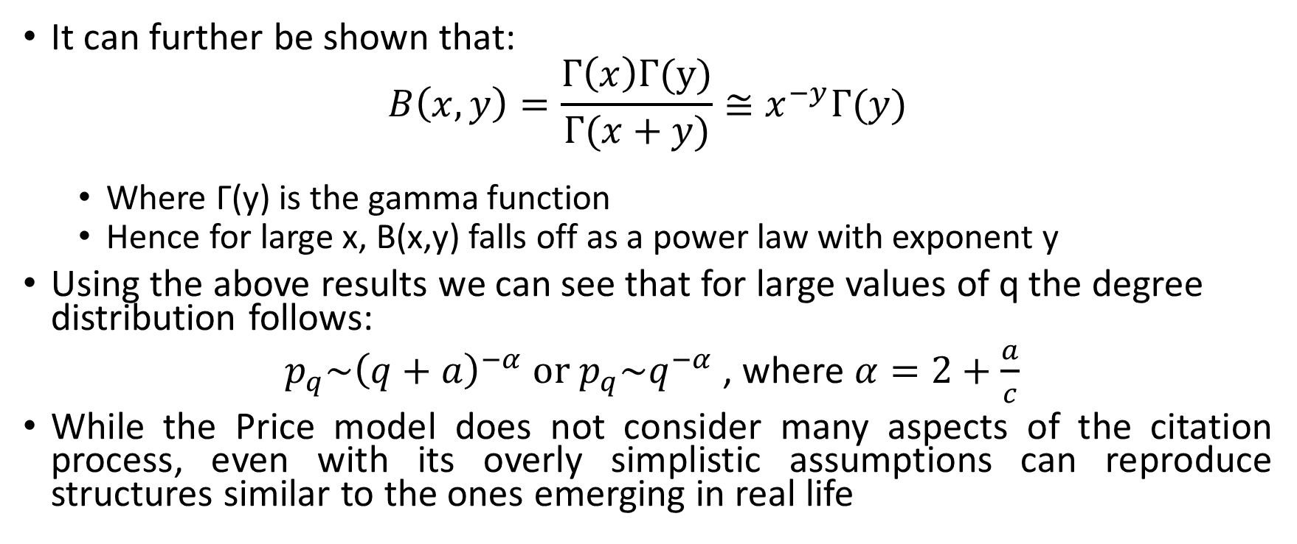
Price Model and power law
It can further be shown that:
$$B\left(x,y\right)=\frac{Γ\left(x\right)Γ(y)}{Γ(x+y)}≅x^{−y}Γ(y)$$
Where Γ(y) is the gamma function
Hence for large x, B(x,y) falls off as a power law with exponent y
Using the above results we can see that for large values of q the degree distribution follows:
$p_{q}\sim {\left(q+a\right)}^{−α} or p_{q}\sim q^{−α}$ , where $α=2+\frac{a}{c}$
While the Price model does not consider many aspects of the citation process, even with its overly simplistic assumptions can reproduce structures similar to the ones emerging in real life

